Slide 1
Office Computer Application WEEK EIGHT
Muhammad Unggul Pamenang

Slide 2
Please Do It With MS PowerPoint from 2010 - 2016

Slide 3
Modifying Themes
1
MS PowerPoint 2016

Slide 4
Introduction
Let's say you really like the style of a theme, but you'd like to experiment with different color schemes. That's not a problem: You can mix and match colors, fonts, and effects to create a unique look for your presentation. If it still doesn't look exactly right, you can customize the theme any way you want.

Slide 5
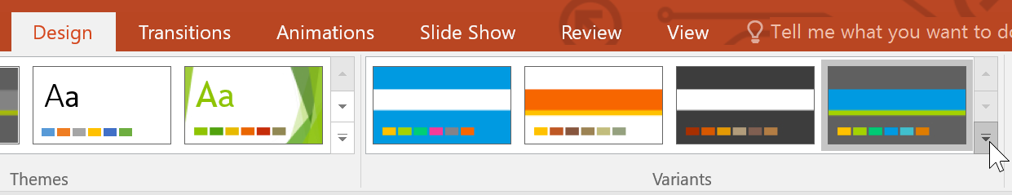
To select new theme colors:
If you don't like the colors of a particular theme, it's easy to apply new theme colors; everything else about the theme will remain unchanged.
From the Design tab, click the drop-down arrow in the Variants group and select Colors.

Slide 6
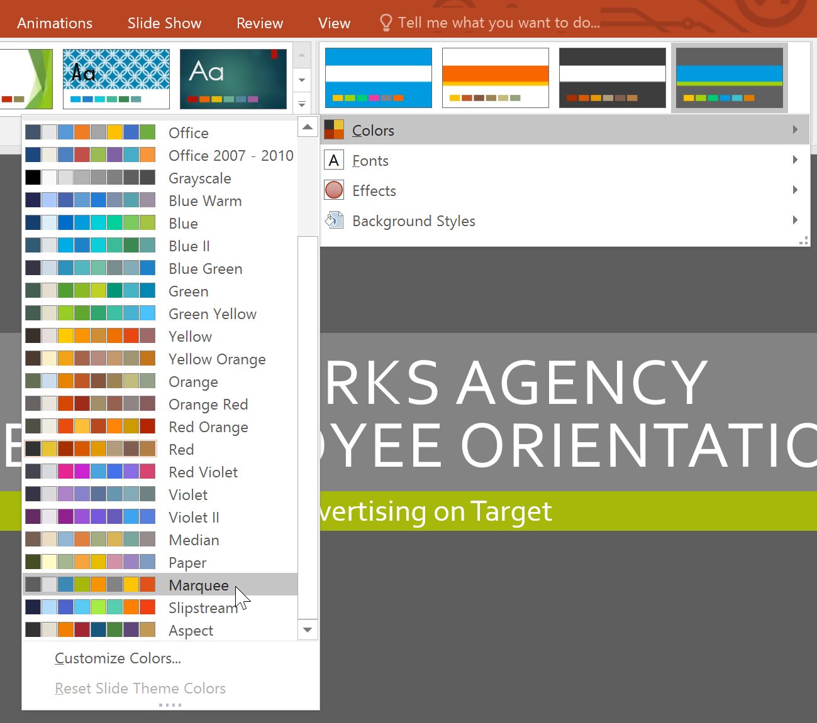
To select new theme colors:
Select the desired theme colors.
The presentation will update to show the new theme colors.

Slide 7
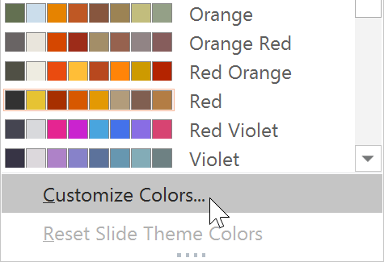
To customize colors:
Sometimes you might not like every color included in a set of theme colors. It's easy to change some or all of the colors to suit your needs.
From the Design tab, click the drop-down arrow in the Variants group.
Select Colors, then click Customize Colors.

Slide 8
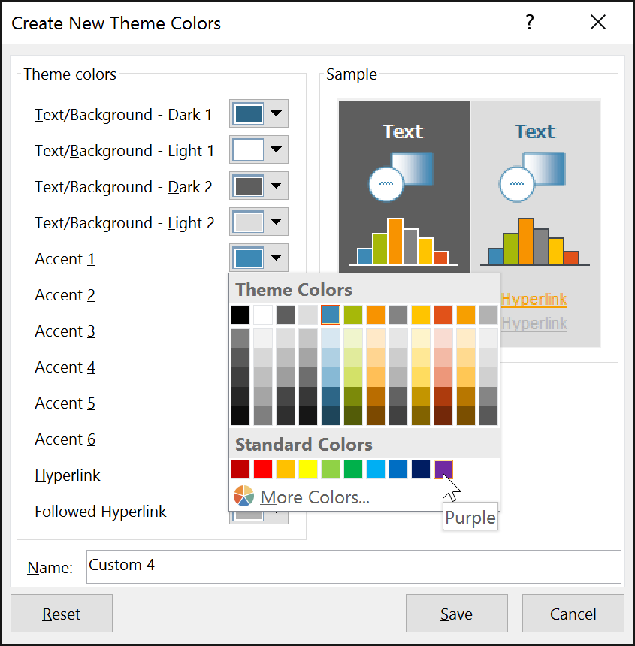
To customize colors:
A dialog box will appear with the 12 current theme colors. To edit a color, click the drop-down arrow and select a different color. You may need to click More Colors to find the exact color you want.

Slide 9
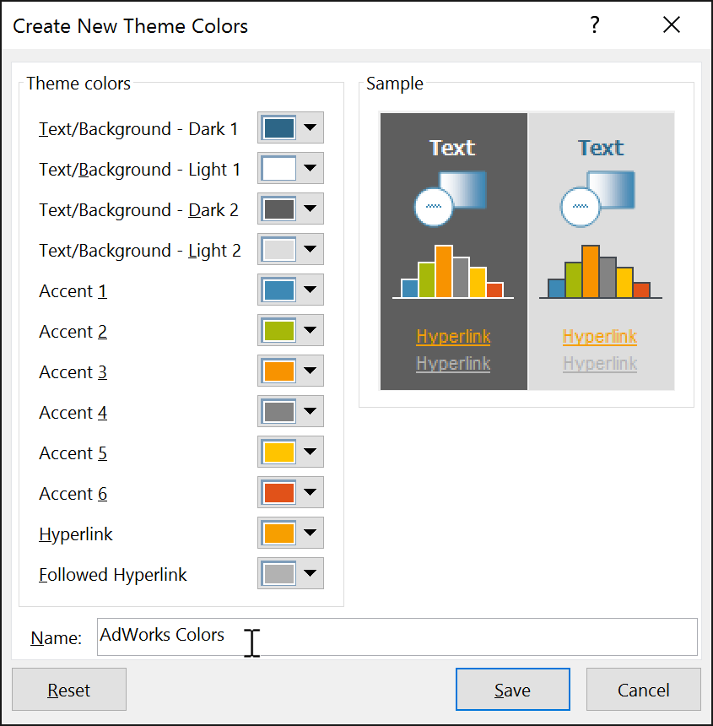
To customize colors:
In the Name: field, type the desired name for the theme colors, then click Save.

Slide 10
To customize colors:
In the Name: field, type the desired name for the theme colors, then click Save.
The presentation will update to show the new custom theme colors.

Slide 11
To select new theme fonts:
It's easy to apply a new set of theme fonts without changing a theme's overall look. The built-in theme fonts are designed to work well together, which can help to unify your presentation.
From the Design tab, click the drop-down arrow in the Variants group and select Fonts.

Slide 12
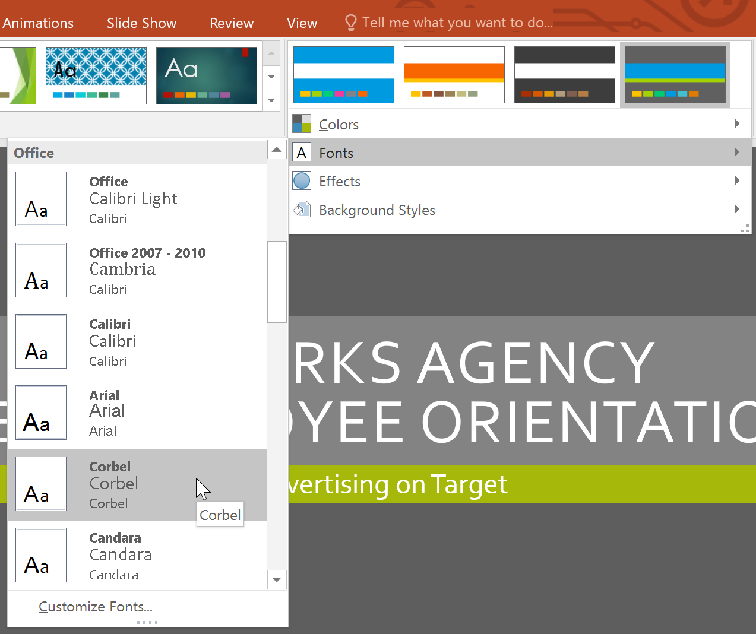
To select new theme fonts:
Select the desired theme fonts.
The presentation will update to show the new theme fonts.

Slide 13
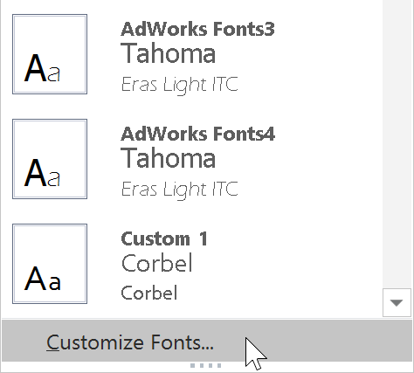
To customize theme fonts:
If you have specific fonts in mind for a presentation, it's easy to choose your own theme fonts.
From the Design tab, click the drop-down arrow in the Variants group.
Select Fonts, then click Customize Fonts.

Slide 14
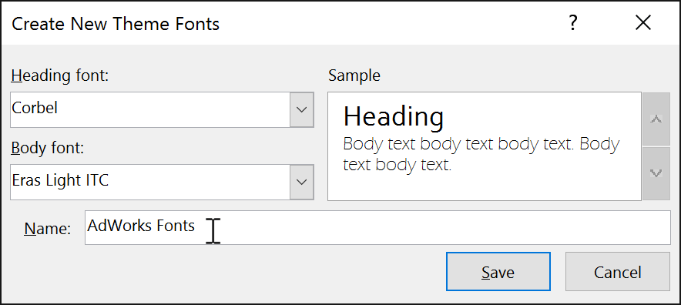
To customize theme fonts:
A dialog box will appear with the two current theme fonts. To change the fonts, click the drop-down arrows and select the desired fonts.
In the Name: field, type the desired name for the theme fonts, then click Save.
The presentation will update to show the new custom theme fonts.

Slide 15
To select new theme effects:
PowerPoint makes it easy to apply new theme effects, which can quickly change the appearance of shapes in your presentation.
From the Design tab, click the drop-down arrow in the Variants group and select Effects.

Slide 16
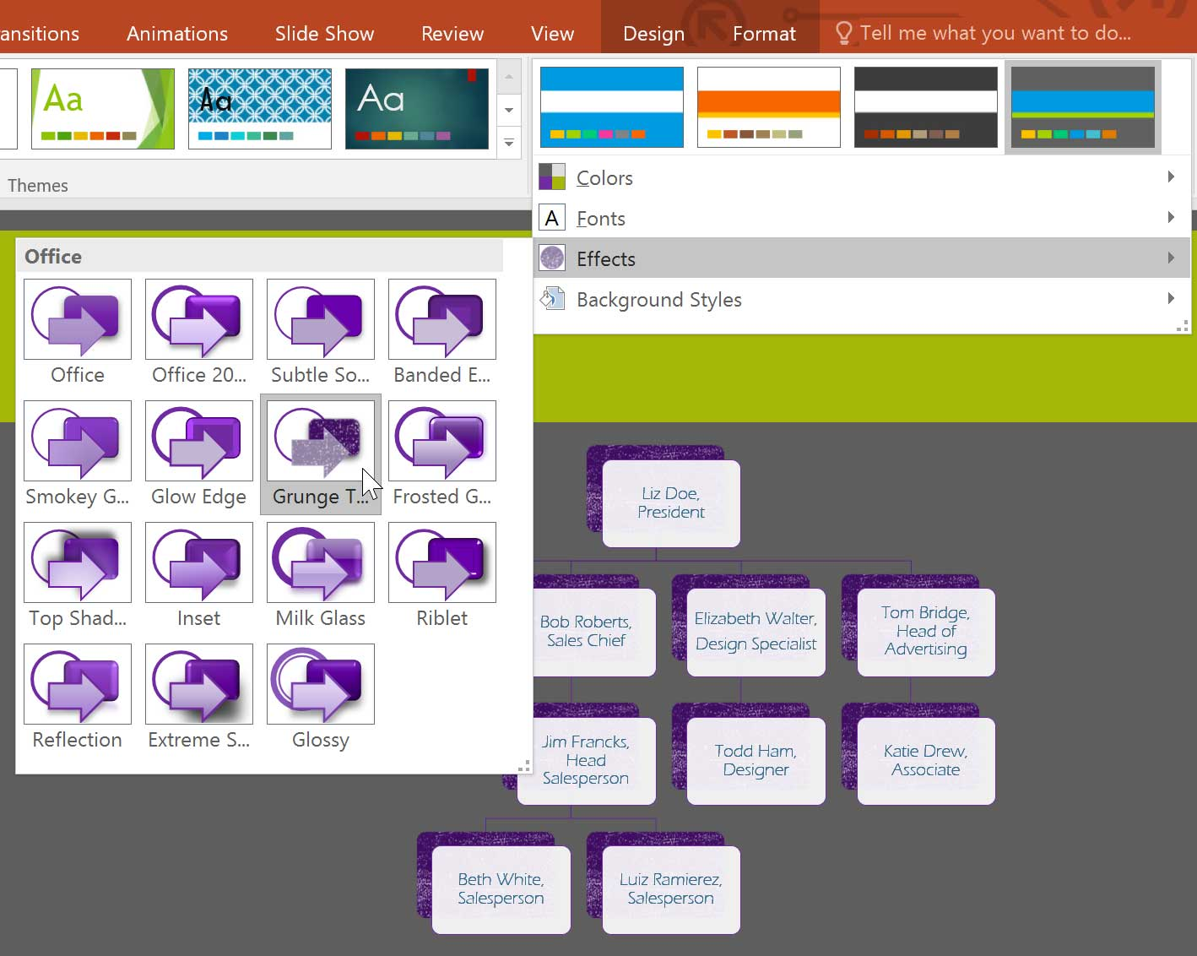
To select new theme effects:
Select the desired theme effects.
The presentation will update to show the new theme effects.

Slide 17
Background styles
To further customize your slides, you can change the background color by choosing a different background style. The available background styles will vary depending on the current theme.

Slide 18
To apply a background style:
From the Design tab, click the drop-down arrow in the Variants group.

Slide 19
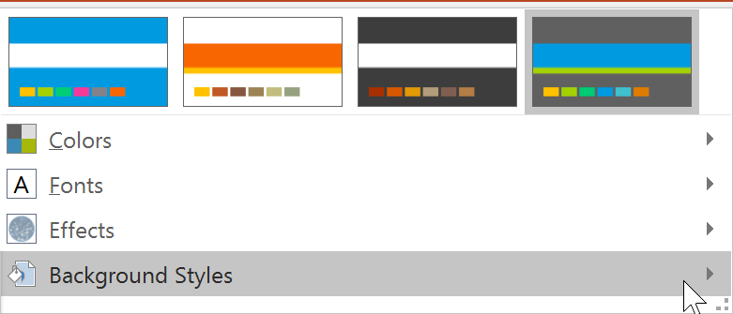
To apply a background style:
Select Background Styles.

Slide 20
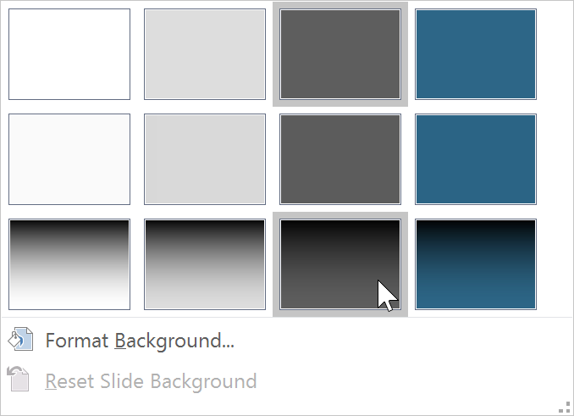
To apply a background style:
Select the desired style. The available styles will change depending on the current theme colors.
The new background will appear in each slide of your presentation.

Slide 21
Saving custom themes
Once you've found settings you like, you may want to save the theme so you can use it in other presentations. If you only want to use the theme in the current presentation, you won't need to save it.

Slide 22
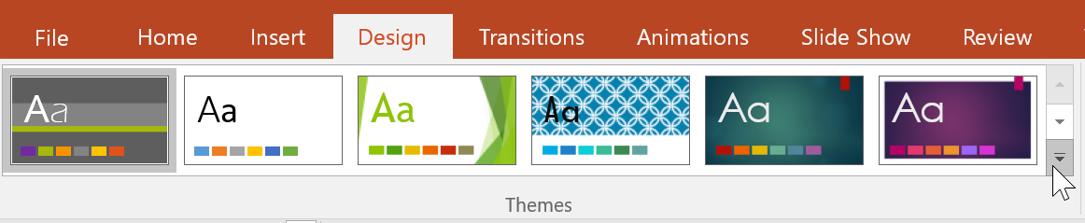
To save a theme:
From the Design tab, click the drop-down arrow in the Themes group.

Slide 23
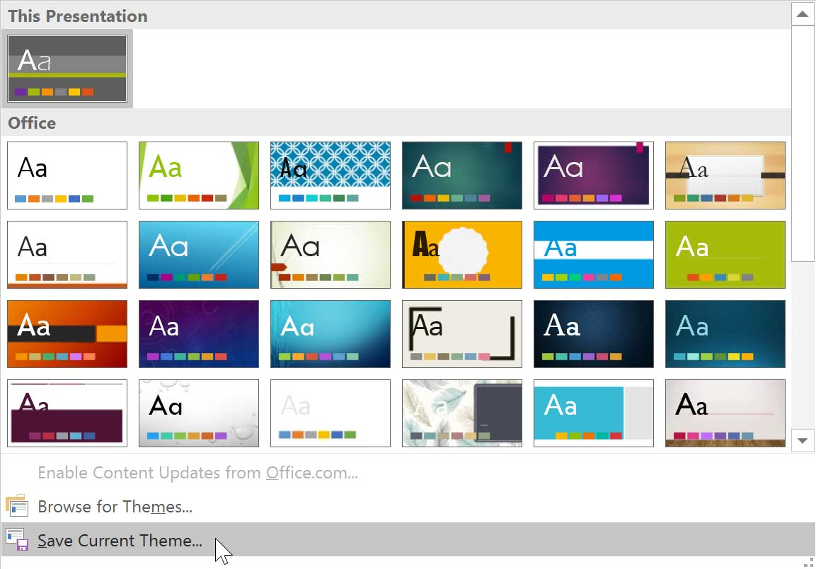
To save a theme:
Click Save Current Theme.

Slide 24
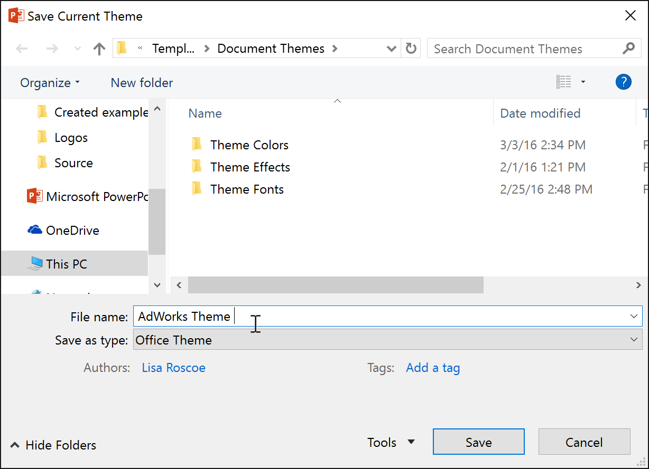
To save a theme:
A dialog box will appear. Type a file name, then click Save.

Slide 25
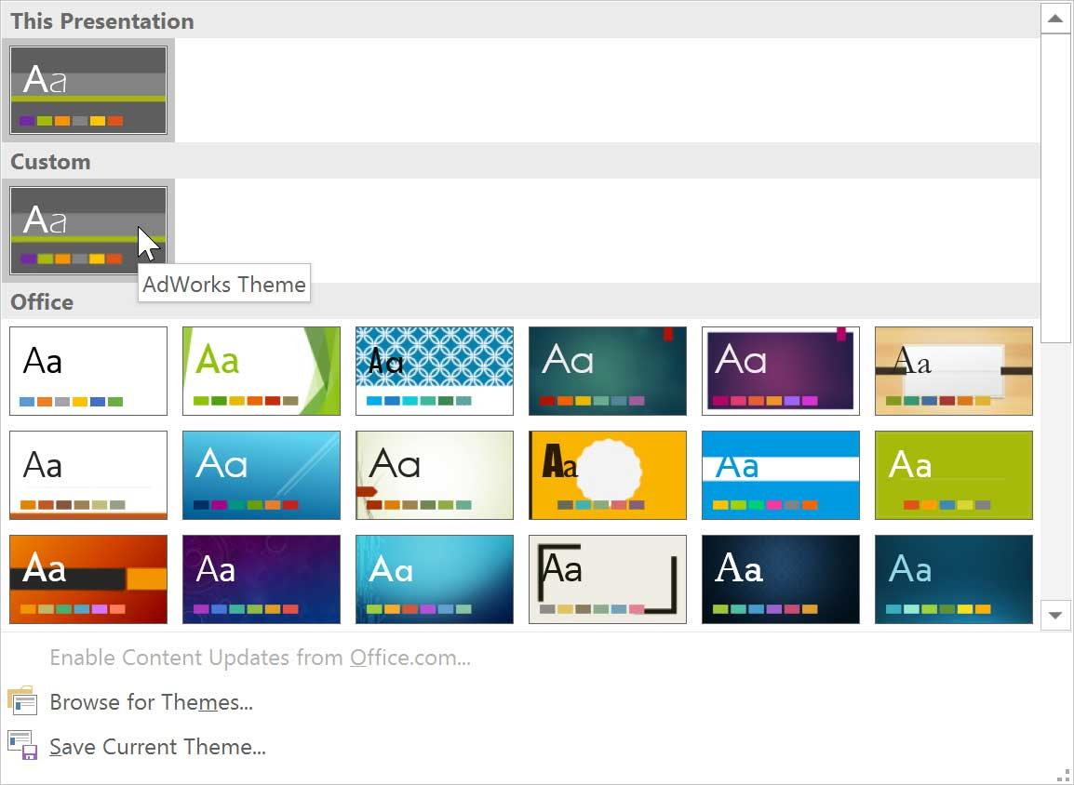
To save a theme:
When you click the drop-down arrow in the Themes group, you'll see the custom theme under Custom.

Slide 26
JOBSHEET
Continue working

Slide 27
THANKS!

